Slide 1
EE 295
TechWriting-Engineering Ethics
Oct 8, 2019
Room E339
Tom Wrappe
EE Lecturer

Slide 2
Agenda
Ethics: Virtue Ethics Review (Ch 5)
Applied to Previous Case Study
Challenger Disaster Followup
Midterm Paper Items
Research Inputs (submitted )
Upcoming Draft Preparation
Focus on Abstract, Exec Summary and Conclusion (Bring A, ES, C draft to Class after draft submission
Preparing for the Final paper)
Final Paper
Topic Overview Paragraph
Topic Draft (submitted)

Slide 3
Makeup Class for Missed Sep 24, 2019 Session
Makeup Class for team (finalized by EE dept):
-6:00 pm Wed, Oct 9 in Room BBC 004 ( Boccardo Business Center)
To be clear, Class will be held on:
Tue (Oct 8), Wed (Oct 9) and Thu (Oct 10) during week of Oct 7

Slide 4
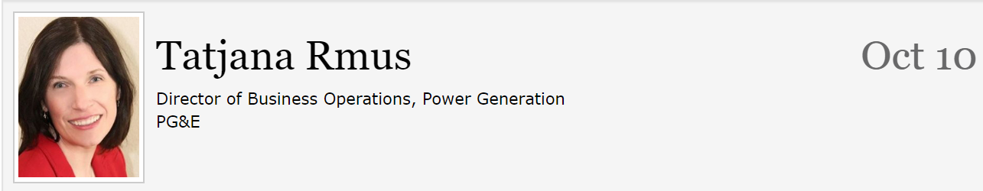
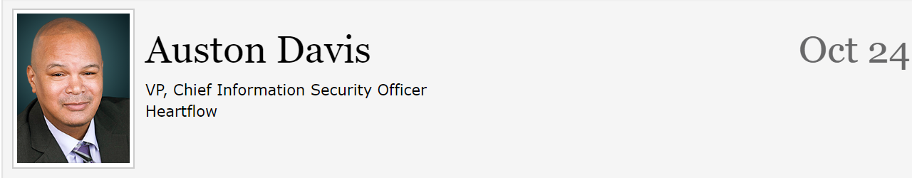
Issues and Reminders (Just a courtesy, not a requirement for lecturer to remind you)
Due date for Midterm Draft moved back to Oct 13@ 11:59pm from Oct 10 (Happy Midterms)
Extra Credit Opportunities remaining

Slide 5
Virtue Ethics
Virtue Ethics
Eugene Moriarity, (2008) “Virtue Ethics, Chapter 5” in The Engineering Project, Its Nature, Ethics and Promise, Penn State Press
Tom Wrappe
EE Lecturer

Slide 6
Ethics Cases: Engineers and Intellectual Property
Virtue Ethics (from class 10, 11, 12)
Objectivity, Honesty and Care are basic virtues by which “virtuosity” is analyzed
Overall virtue is weighted average of the basic variables
Application/judgment of the weighting factors is driven by phronesis (wisdom) of the investigator
YOU will be challenged to be virtuous by Intellectual Property in your engineering career. Your life and others can be seriously impacted if you do not consider Virtue Ethics at these critical times

Slide 7
Plagiarism and Teams
Pete works for CISCO and is given his first major project from his Manager. The project is a team effort and one week before the project is due, Pete finds out that Valeria has chosen to “copy and paste” a majority of her “background and introduction”. Pete confronts Valeria and asks her to redo her paper without plagiarizing, but Valeria claims she is too busy . She assures Pete that their Manager will never discover the plagiarism, and that, if he does, that she will take complete blame for it.
Pete finds himself in an extremely uncomfortable position. He feels partly responsible for the plagiarism that he discovered; however, Valeria claims she will take all of the blame.

Slide 8
Virtue Ethics
Where was Objectivity Displayed by Pete, Valeria and the Manager?
2. Where was Honesty displayed?
3. What should Peter Care about? Multiple answers
4. What is the prudent decision for the manager of the group?

Slide 9
Challenger Disaster
-Virtue ethics displayed by some involved
-Ignored by others
Background Facts:
-Launch originally scheduled for Jan 22, 1986, and was delayed 4 times due to multiple issues
-7 crew members all killed in explosion
-Root cause determined to be O-ring failure on the solid rocket booster build by Morton Thiokol

Slide 10
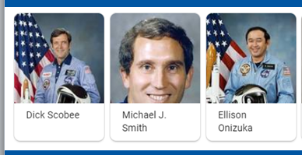
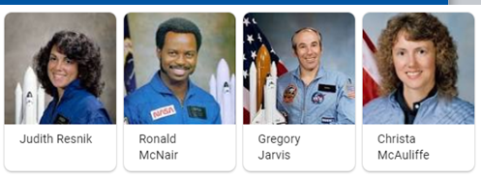

Slide 11
Fair Warning
-In Class writing exercise within next two weeks : On or before Oct 17, 2019
-May be at BEGINNING of class with 30 min allowed INCLUDING Instructions (which begin promptly at 4:30pm or 7:30pm)
-Attend your own section unless granted permission at least 24 hours in advance

Slide 12
Feedback on Blockchain
Item | Issue Description | Example | Action to Address
1 | Paragraph Structure -No topic sentence or more than one topic sentence | Blockchain is a secure ledger. (topic). A Japanese inventor made Bitcoin | 1. Structure Test. Does every sentence in para support topic sentence?
2 | Flow -Do paragraphs have the correct flow from general to specific as the outline? | Blockchain has data blocks with hash values. …. Blockchain is a secure ledger | 1. Read the topic sentences and see the flow from general to specific and following the outline
3 | Passive Voice | Blockchain tech was applied to make Bitcoin → better: Bitcoin applied Blockchain tech | Search for “is..”, “ was” and “wll be” and make sure no passives
4 | Title “No-No’s”: -Generics (Out of Class assign) -Questions in Title -Poor Caps | -What is Blockchain? -description of blockchain Technology | -Descriptive title with all Caps for words of more than 3 letters
5 | Unsupported statements | Everyone thinks of Blockchain when they hear smart tech…. | Do not make statements that you cannot back up (does everyone really do that?
6 | Contractions, especially Let’s (let us) | Let’s look at this situation. (Let us = personal pronoun) | Non contractions EVER

Slide 13
Semester Major Items…..(subject to modification)
 | Mid Term | Resume | Final Paper | Final Presentation (slides )
Topic Paragraph | 9.5.19
Topic Proposed | 9.12.19 |  | 10.3.19
Topic Final | 9.19.19 |  | 10.10.19
Outline/ Abstract | 9.26.19 |  | 10.31.19
Research | 10.1.19 | 10.24.19 (Class) | 10.15.19
Draft Complete | 10.13.19 ** |  | 11.7.19 | 11.19.19
Final Submit | 10.22.19 | 11.14.19 | 11.26.19 | 12.3.19
Final Presentation | NA | NA | NA | 12.17.19 (Sect 1) 12.12.19 (Sect 2)

Slide 14
A Step Closer to Midterm
Step | Due | Notes
Discuss a topic | 9.5.19 | 1 paragraph on end product (Bring to Class)
Propose a topic/ company | 9.12.19 | 600 words overview of the paper (Turnin)
Abstract/Outline | 9.26.19 | Skeleton of the paper
Research Deliverable | 10.1.19 | Support Element
Draft | 10.13.19 ** | Complete paper, but needing edit
Final Submission | 10.22.19 | Final product

Slide 15
Feedback on Midterm Research
Item | Description | Example | Action to address
1 | Not using full IEEE format especially for online sources | Hyperlink only | Relook IEEE citations (backup in this deck)
2 | Title either generic or improper caps | Research on self parking Garage | Capitals on all words in title of 4 or more letters
3 | Paragraphs not structured properly—no topic sentence or multiple topic sentences |  | Do all sentences in the paragraph support topic sentence?

Slide 16
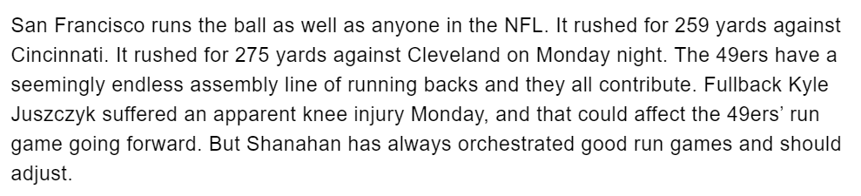
Paragraphs Have One Topic
This paragraph passes the “Structure Test”:
a. Topic Sentence is first sentence.
b. Every other sentence supports the Topic Sentence by mentioning some aspect of the running game

Slide 17
First 5 page Proposal A Concise version of a Business Plan
Outline | Outline/ Abstract | Draft (5 pages) | Midterm paper (5 pages) | Final Paper ? 15 pages
1. Abstract | Paragraph | ½ page max | ½ page max
2. Executive Summary | paragraph | ½ to 1 page | ½ to 1 page
3. Product Description | 2 paragraphs or so | 1-3 pages
4 Mkt Research and Analysis | 1-2 paragraphs (5 sources min) | 1-3 pages | Depends on sources
5. Finance and Economics | Short paragraph | ½ to 1 page
6. Management Team | Short paragraph | ½ page
7. Risks and Assumptions | Short paragraph | ½ page
8. Conclusions and Recommendations | Short paragraph | ¼ to ½ page
A. Sources | Not Applicable | ½ to 1 page | ½ to 1 page
The outline endures while the content grows

Slide 18
Midterm: First Draft
A first complete paper with all the elements in the outline in the right proportions
Structurally in the final form
Topic Sentences have final content, but may be “tightend up in final”
Read topic sentences of Draft and get the flow of the paper
Set up for success, but not “polished”
Abstract, Executive Summary, Conclusion are finalized last, after the Body of the paper
Body (Product Proposal and Market/product research are complete in content, but not necessarily as concise as the final)
Draft likely longer than Final
Add conciseness: Reduce wordiness/filler, remove/rewrite words to make simpler
5. Incorporates Checklist to ensure complete paper elements
6. Peer Review two papers from the class (mostly to get the process down)

Slide 19
Peer Review
You will implement 2 Peer Reviews as part of the exercise
Complete no later than Oct 17 (papers due by Oct 13)
Canvas Peer Review Process Video
-Complete Checklist for a. Content and b. Grammar
-Provide Peer Reviews
-Validate each paragraph
a. Flow Test: Flow of paper consistent with reading topic sentences of paragraphs
b. Support Test: Topic sentence of each paragraph is supported by each of the other sentences in the paragraph

Slide 20
Midterm: First 5 Page Report
The First 5 Page Report will be a Proposal/Business Plan focused on adding a new product to the product line or entering a new area
-Target audience is “your boss” who wants to get the project approved
-Arm her/him with the convincing approach and supporting facts to get the project moving
-Topic areas suggested, but specific paper topic should be put forth by the student
Submit candidate topic writeup (600 words) for approval
Develop interim and final deliverables per Canvas schedule

Slide 21
Class Exercise 3.14
For 3.14 (after you submit draft of Midterm 3.13)
Bring a printout of your Abstract, Executive Summary and Conclusion paragraph (s) to class to exchange with team members
Inputs will help craft the final versions of these important paragraphs due 3.19

Slide 22
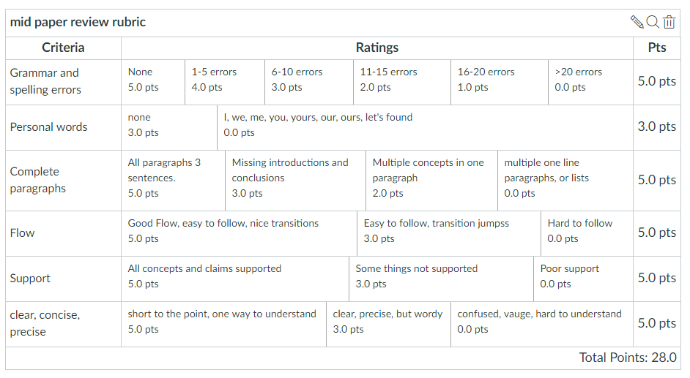
Midterm Paper Rubric

Slide 23
2nd & 3rd Five Page Reports (Final Paper): Initial Input
The last 10 pages can be a continuation of the Proposal IF you are taking EE297 or EE299. This 15 page Proposal will then be used as a Proposal for your Project.
or
If you are not planning on taking EE297 or EE299 the last 10 pages can be a Research Report for a chosen approved area.
The SPECIFIC Topic should be submitted for approval (selected topics will be presented to the class)

Slide 24
Oct 3 Final Topic Assignment (Expanded Midterm Paper)
Prepare and submit a document of >600 words that describes your preferred topic for the Final Paper ( 1. Extended Product Proposal or 2. Research Paper).
Note: the ultimate Final Paper has the following description (1 or 2):
1. Extended Midterm Paper (Final paper will be a total of 15 pages that expands the midterm topic that builds on the First 5 Page Report)
The First 5 Page Report (Midterm) will be a Proposal/Business Plan focused on adding a new product to the product line or entering a new area
-Target audience is “your boss” who wants to get the project approved
-Arm her/him with the convincing approach and supporting facts to get the project moving
-Topic areas suggested, but specific paper topic should be put forth by the student
Submit candidate topic write-up (600 words)
If you choose to provide an Extended Midterm paper, then include a DESCRIPTION OF HOW YOU WILL EXPAND THE EXISTING MIDTERM BY 10 PAGES (such as a. expand the Product Description to more detail of the component technologies or b. expand the market research and the competitive research/analysis)

Slide 25
Research Paper Topic
2. Research topic paper based on IEEE format that investigates an area of emerging technology with application to Electrical Engineering
-10 pages minimum of original research for the final paper
For the 600 word Topic Proposal address each of the following in a well structured approx 2 pager paper:
-What is the area?
-Why is the area relevant?
-What areas of research will you undertake in the investigation?
-Why did you choose this area?
3. Provide a Self-Grading page at the end of your submission that addresses a. word count b. underline topic sentences for each paragraph, c. Check for passive voice, d, confirm no use of "very" and e. no personal pronouns

Slide 26
Final Paper Topic Items
Item | Description | Example | Action to Address
1 | Referring to the “project” instead of the “product” or “research topic”. Project is to implement project or research | The proposed project is Adding AI to network controller | Define your product or your research topic
2 | Proposing a “concept” :too vague | The concept of the paper is…. | Answer right away, what is the product or what is the research topic?
3 | Using questions in topic or in first line of paragraph | What is the real way to implement AI in IoT? | No questions in titles or topic sentences. Redundant
4 | Making a background paragraph before saying what the topic is | 1. The world of technology is changing day to day… 2. The proposed product is….. | Put the description of the topic in the first paragraph and then provide background

Slide 28
Citations

Slide 29
IEEE Author Center
-IEEE articles and journals have a set process to provide consistency
-http://ieeeauthorcenter.ieee.org/submit-your-article-for-peer-review/the-ieee-article-submission-process/
-Process overview posted on Canvas (Trans_Jour template)
-Provides detail on authoring, peer review, figures, tables for professional journal and symposia submissions

Slide 30
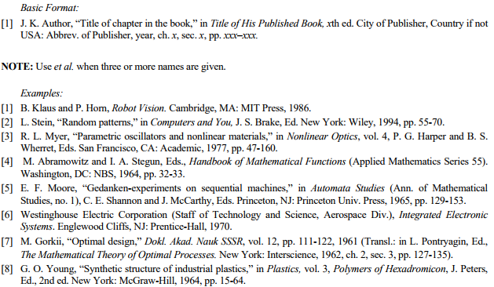
IEEE Citations
Books

Slide 31
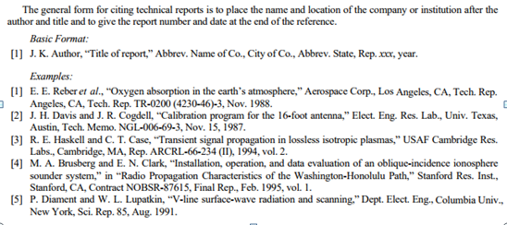
IEEE Citations
Reports

Slide 32
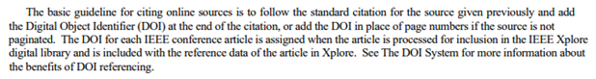
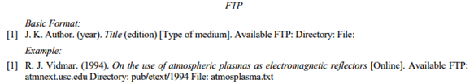
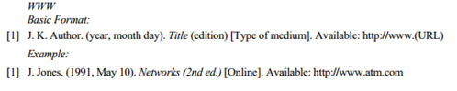
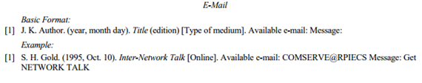
IEEE Citations
Online Sources

Slide 33
Addendum to Online Citations: Include “Accessed” Date
Material Type | In-Text Citation | Reference List Entry
Electronic Document | [27] | [27] European Telecommunications Standards Institute, “Digital Video Broadcasting (DVB): Implementation guidelines for DVB terrestrial services; transmission aspects,” European Telecommunications Standards Institute, ETSI TR-101-190, 1997. [Online]. Available: http://www.etsi.org. [Accessed: Aug. 17, 1998].
Government Publication | [28] | [28] Australia. Department of of Education, Employment and Workplace Relations, Survey on Changes in Awareness and Understanding of Science, Engineering and Technology: Report on findings. Canberra: The Department; 2008. [Online]. Available: http://www.dest.gov.au/NR/rdonlyres/241263CF-8585-4EEC-B104-C947C6C18029/23713/SurveyonChangesinawarenessunderstandingofSET.pdf. [Accessed: Sept. 7, 2010].
Whole Internet Site | [29] | [29] J. Geralds, "Sega Ends Production of Dreamcast," vnunet.com, para. 2, Jan. 31, 2001. [Online]. Available: http://nl1.vnunet.com/news/1116995. [Accessed: Sept. 12, 2004].

Slide 34
The Final Report (10 pages past the Midterm)

Slide 35
Midterm: First 5 Page Report
The First 5 Page Report is a Proposal/Business Plan focused on adding a new product to the product line or entering a new area
-Target audience is “your boss” who wants to get the project approved
-Prepare a concise Product Description including what makes the product “special” and differentiated vs other similar products
-Breadth set with outline
-Depth of Product Description/Market Research are limited to 5 pages
Scheduled complete Midterm submission is Mar 19, 2019
-Strong focus on Abstract, Exec Summary, Conclusion

Slide 36
The Final Report
The followon 10 pages can be a continuation of the Proposal IF you are taking EE297 or EE299. This 15 page Proposal will then be used as a Proposal for your Project.
or
If you are not planning on taking EE297 or EE299 the last 10 pages can be a Research Report.
The SPECIFIC Topic should be submitted for approval (selected topics will be presented to the class)

Slide 37
Final Research Report Options
Propose a term paper topic. This topic could be research and results you wish to study, a masters project research proposal, a business plan for a new product (that expands on the Midterm).
Write a >300-word proposal (1/2 page), submit on Canvas.
Submit via Turnitin and achieve <15% Plagiarism score
Due Mar 14, 2019

